Slide 1

Cultural Differences
Workplace Diversity
Cultural Differences
  Communication Style
  Development of Trust
  Scheduling Preferences

Slide 2

Communication Style
Low Context
  Precise, simple, clear
  Repetition expected
High Context
  Sophisticated, nuanced, layered

Slide 3

Communication Style
Build awareness
Facilitate conversation
Tailor communication
Mitigate disagreements and misunderstandings

Slide 4

Development of Trust
Task-based
  Business related
  consistency, reliability
Relationship-based
  Sharing meals, evening drinks

Slide 5
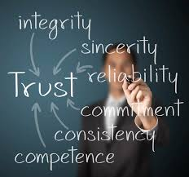
Development of Trust
Build awareness
Assign diverse work teams
Facilitate relationship building activities
  Office potluck
  Company retreat

Slide 6

Scheduling Preference
Linear Time
  Sequential order
  Promptness, structure, organization
Flexible Time
  Fluid, rapidly adapting

Slide 7

Scheduling Preference
Linear Time
  Structured meetings
  Enforcing accountability
Flexible Time
  Flexible work schedule
  Brainstorming sessions

